Slide 1
Performance and Pipelines
CS 2200 Summer 2023

Slide 2
Metrics
If we’re going to try to make processors better, we’re going to have to take measurements
Common Metrics:
Space ➔ memory footprint
Time ➔ execution time
Instruction frequency
Static
Dynamic
Benchmarks

Slide 3
What determines execution time?
We’ll use the abbreviation CPI for ”Cycles Per Instruction” so we can talk about the number of clock cycles each instruction takes.
Execution time = (∑ CPI_{j}) * clock cycle time, where 1 ≤ j ≤ n
That’s a pretty tough sum to compute because modern computers can execute billions of instructions per second
Execution time = n * CPI_{Avg} * clock cycle time, where n is the number of instructions (executed not static instruction count)

Slide 4
What’s the execution time?
1 GHz processor; 10K instructions; CPI_{Avg} = 3
3 msec
1 GHz
0.03 msec
300 µsec
30K
10
Not enough information to compute
10⁻⁹ sec/cy
10⁴ inst
3 cy/inst
= 3 x 10⁻⁵ sec
= .00003 sec
= .03 msec
= 30 µsec
Today’s Number 30,030
10

Slide 5
Instruction Frequency
Static instruction frequency refers to number of times a particular instruction occurs in compiled code.
Impacts memory footprint
If a particular instruction appears a lot in a program, can try to optimize amount of space it occupies by clever instruction encoding techniques in the instruction format.
Dynamic instruction frequency refers to number of times a particular instruction is executed when program is run.
Impacts execution time of program
If dynamic frequency of an instruction is high then can try to make enhancements to datapath and control to ensure that CPI taken for its execution is minimized.

Slide 6
Static instruction frequency…
Refers to the type of instruction in the instruction-set
Refers to the frequency of occurrence of instructions in compiled code
Refers to the frequency of occurrence of instructions that actually get executed
Refers to the clock frequency of the processor
Is the basis for datapath design
20

Slide 7
Dynamic instruction frequency…
Refers to the type of instruction in the instruction-set
Refers to the frequency of occurrence of instructions in compiled code
Refers to the frequency of occurrence of instructions that actually get executed
Refers to the clock frequency of the processor
Is the basis for datapath design
30

Slide 8
ADD instruction occurs twice in a program that contains a total of 1000 instructions in the compiled code. All 1000 instructions get executed during a program run. One of the ADD instructions is in a 5-instruction loop that gets executed 1000 times.
What is the static frequency of ADD?
Two
0.2%
(1000/5995) * 100%
(1001/5995) * 100%
(1/5000) * 100%
(1001/5000) * 100%
40

Slide 9
ADD instruction occurs twice in a program that contains a total of 1000 instructions in the compiled code. All 1000 instructions get executed during a program run. One of the ADD instructions is in a 5-instruction loop that gets executed 1000 times.
What is the dynamic frequency of ADD?
Two
0.2%
(1000/5995) * 100%
(1001/5995) * 100%
(1/5000) * 100%
(1001/5000) * 100%
ADDs executed:
1 + 1000 = 1001
Total executed:
1000 inst – 5 inst
+ 1000 * 5 = 5995
50

Slide 10
Benchmarks
Benchmarks are a set of programs that are representative of the workload for a processor.
The key difficulty is to be sure that the benchmark program selected really are representative of the prospective workload.
Standard benchmark suites (SPEC, LINPACK, Whetstone, Dhrystone, and many more) are used to try to compare “apples” with “apples” by summarizing performance across a set of programs
E.g. SPEC uses perl, gcc, AI apps, compression, imaging apps, modeling apps, etc. to represent a common workload
A radical new design is hard to benchmark because there may not yet be a compiler or much code.

Slide 11
Composite execution times
Total execution time: This metric is the cumulative total of the execution times of the individual programs
Arithmetic mean: This metric may bias the summary value towards a time-consuming benchmark program (e.g. P1 = 100; P2 = 1; AM = 50.5).
Geometric mean: This metric removes the bias present in arithmetic mean (e.g. P1 = 100; P2 = 1; GM = sqrt(100*1) = 10).
Weighted arithmetic mean: This metric takes into account the relative frequency of execution of the programs in the benchmark mix (e.g. P1 = 100; P2 = 1; f_{P1} = 0.1; f_{P2} = 0.9; WAM = 10.9).
Harmonic mean (HM): It is computed by taking the arithmetic mean of the reciprocals (e.g. P1 = 100; P2 = 1; HM = 1/( ( (1/100) + (1/1) )/2 ) = 1.9801)
Bias to high
In the middle
Bias to low

Slide 12
Summary of metrics
Name | Notation | Units | Comment
Memory footprint | - | Bytes | Total space occupied by the program in memory
Execution time | (∑ CPI_{j}) * clock cycle time, where 1 ≤ j ≤ n | Seconds | Running time of the program that executes n instructions
Arithmetic mean | (E₁+E₂+…+E_{p})/p | Seconds | Average of execution times of constituent p benchmark programs
Weighted Arithmetic mean | (f₁*E₁+f₂*E₂+…+f_{p}*E_{p}) | Seconds | Weighted average of execution times of constituent p benchmark programs
Geometric mean | p^{th} root (E₁*E₂* …*E_{p}) | Seconds | p^{th} root of the product of execution times of p programs that constitute the benchmark
Static instruction frequency |  | % | Occurrence of instruction i in compiled code
Dynamic instruction frequency |  | % | Occurrence of instruction i in executed code
Speedup (M_{A} over M_{B}) | E_{B}/E_{A} | Number | Speedup of Machine A over B
Speedup (improvement) | E_{Before}/E_{After} | Number | Speedup After improvement
Improvement in Exec time | (E_{old}-E_{new})/E_{old} | Number | New Vs. old
Amdahl’s law | Time_{after} = Time_{unaffected} + Time_{affected}/x | Seconds | x is amount of improvement

Slide 13
Using a benchmark
Some caveats:
Based on the biases of composite functions, we have to be very cautious using a single composite metric
Processor performance isn’t determined just by the clock cycle rating of the processor – memory organization and memory—processor—bus bandwidths are also key
Some processors do well on certain benchmark programs and other do well on other programs
A composite index can be useful when we want to compare two processors without knowing the exact kind of workload they are going to run, but
We must be very cautious about the over use of metrics
Don’t forget the cliché “Lies, damned lies, and statistics”

Slide 14
Reasons to be skeptical of a benchmark
The vendor gave you the benchmark results (in polite company, we call this a conflict of interest)
The vendor wrote the benchmark suite
The benchmark suite doesn’t seem to have any elements that represent your workload (e.g. you run web server farms and the benchmark represents only computationally intensive scientific calculations)
The equipment being benchmarked is different from the equipment you want to evaluate (maybe a little different, maybe a lot different)
The benchmark uses a different compiler suite than you plan to use
The cost of mistakenly choosing the wrong equipment is very high

Slide 15
In creating a composite performance metric, using an arithmetic mean
Reduces biases included in the geometric mean
May bias the summary towards time-consuming programs in the benchmark
Yields a cumulative total of the execution times of the individual programs
Takes into account the relative frequency of the execution of the programs in the benchmark
60

Slide 16
Using SPEC CPU benchmarks
There’s a 2017 version now available
SPEC actually publishes four composite metrics: SPECspeed_int, SPECspeed_fp, SPECrate_int, and SPECrate_fp
We’re going to look at SPECrate_int which measures mostly multi-threaded integer performance (e.g. those of interest for a software development server).
Let’s take a look. Note how much more information is presented than just a simple composite number. This is a hint about how many variables they’re trying to control, nearly an impossible task.

Slide 17
Comparing two real systems
So which one would you recommend? Both are similar HPE server chassis: DL380 or DL365
 | Intel Platinum 8490H | AMD EPYC 9654
Clock | 1.9 GHz (up to 3.5GHz) | 2.4 GHz (up to 3.7GHz)
Cores (cpus) | 120 | 192
System | HPE DL380 (2 chips) | HPE DL365 (2 chips)
SPECrate2017_int | 948 | 1620
CPU Cost (9/2021) | $17,000 (list) | $11,805 (list)

Slide 18
The need for speed!
So how do we improve performance?
Reduce execution time (of course)
How?
The execution time equation tells us:
Execution time = N * CPI * Cycle Time
How can we reduce the left-hand side?
Reduce one or more of the right-hand factors

Slide 19
How can we measure improvement?

Slide 20
It takes me 8 minutes to walk to class from my office. I can run twice as fast as I walk. If I walk half the distance and run the remaining half, how much time will I take to reach class from my office?
8 mins
4 mins
6 mins
2 mins
How does this relate to CS 2200?
Today’s number is 19,654
8 = d/v n = ½ d/v + ½ d/2v
8v = d
n = 4v/v + 4v/2v
n = 4 + 2
n = 6
70

Slide 21
Amdahl’s Law
My office walk: 6 = 4 * 1/2 + 4
This is perhaps a little easier way to think about these problems

Slide 22
Improving an instruction
A processor spends 20% of its time on ADD instructions. An engineer proposes to improve the speed of the ADD instruction by 4 times. What is the speedup achieved by this modification?
The improvement only applies for the ADD instruction, so 80% of the execution time is unaffected by the improvement.
Time = .2 / 4 + .8 = 0.85
Speedup = 1 / .85 = 1.18 (or 18% improvement)

Slide 23
A processor spends 10% of its time on ADD instructions. An engineer proposes to improve the speed of the ADD instruction by 3 times. What is the speedup achieved by this modification?
62%
15%
18%
7%
Original normalized execution time = 1
New execution time = (time spent in ADD/4)
+ remaining time
= 0.1 / 3 + .9
= 0.933
Speedup = execution time before
/execution time after
= 1 / 0.933 = 1.07 = 7%
Today’s number is 71,771
80

Slide 24
Summary of metrics
Name | Notation | Units | Comment
Memory footprint | - | Bytes | Total space occupied by the program in memory
Execution time | (∑ CPI_{j}) * clock cycle time, where 1 ≤ j ≤ n | Seconds | Running time of the program that executes n instructions
Arithmetic mean | (E₁+E₂+…+E_{p})/p | Seconds | Average of execution times of constituent p benchmark programs
Weighted Arithmetic mean | (f₁*E₁+f₂*E₂+…+f_{p}*E_{p}) | Seconds | Weighted average of execution times of constituent p benchmark programs
Geometric mean | p^{th} root (E₁*E₂* …*E_{p}) | Seconds | p^{th} root of the product of execution times of p programs that constitute the benchmark
Static instruction frequency |  | % | Occurrence of instruction i in compiled code
Dynamic instruction frequency |  | % | Occurrence of instruction i in executed code
Speedup (M_{A} over M_{B}) | E_{B}/E_{A} | Number | Speedup of Machine A over B
Speedup (improvement) | E_{Before}/E_{After} | Number | Speedup After improvement
Improvement in Exec time | (E_{old}-E_{new})/E_{old} | Number | New Vs. old
Amdahl’s law | Time_{after} = Time_{unaffected} + Time_{affected}/x | Seconds | x is amount of improvement

Slide 25
Execution time?
CPI of Instruction Classes | Code 1 Uses | Code 2 Uses
R-type = 2 | 3 | 10
I-type = 10 | 3 | 1
J-type = 3 | 5 | 2
S-type = 4 | 2 | 3
13 inst
6+30 +15+8 =
59 cycles
16 inst
20+10+6+12 =
48 cycles
Code 1 is better than Code 2 since it has fewer instructions
Code 2 is better than Code 1 since it has fewer instructions
Code 1 is better than Code 2 since it takes fewer total clock cycles to execute
Code 2 is better than Code 1 since it takes fewer total clock cycles to execute
I cannot count
90

Slide 26
Architecture change?
We have a computer with three types of instructions that have the following CPI:
An architect determines that he can reduce the CPI for B to 3 but will need to slow the clock speed of the processor. What is the maximum permissible slowing of the clock that will make this change worthwhile.
Assume that all the workloads for this processor use 30% of A, 10% of B, and 60% of C types of instructions
Type | CPI
A | 2
B | 5
C | 1

Slide 27
How do we answer that?
Execution time of the old machine:
ET_{o} = N * (F_{Ao} * CPI_{Ao} + F_{B} * CPI_{Bo} + F_{C} * CPI_{Co}) * C_{o}
(where Fx and CPIx are the dynamic frequencies and CPIs of each type of instruction, respectively)
ET_{o} = N * (0.3 * 2 + 0.1 * 5 + 0.6 * 1) * C_{o} = N * 1.7 * C_{o}
Execution time for the new machine:
ET_{n} = N * (0.3 * 2 + 0.1 * 3 + 0.6 * 1) * C_{n} = N * 1.5 * C_{n}
For the design to be viable,
ET_{n} < ET_{o}
N * 1.5 * C_{n} < N * 1.7 * C_{o}
C_{n} < 1.7/1.5 * C_{o}
C_{n} < 1.13 * C_{o}
Maximum permissible increase in clock cycle time = 13%

Slide 28
Combining two instructions?
Instruction | CPI
Add | 2
Shift | 3
Others | 2
Add/Shift | 4
If the sequence ADD followed by SHIFT appears in 20% of the dynamic frequency of a program, what is the speedup of the program with all {ADD, SHIFT} replaced by the combined instruction?
[HINT: For every 10 instructions in the original program, 2 instructions are the ADD/SHIFT combo. Thus the number of instructions in the new program shrinks to 90% of the original program.]

Slide 29
A solution
ET_{o} = N * (F_{ADD} * 2 + F_{SHIFT} * 3 + F_{others} * 2) * C = N * (0.1 * 2 + 0.1 * 3 + 0.8 * 2) * C = 2.1NC
With the combo instruction replacing {ADD SHIFT}, the number of instructions in the new program shrinks to 0.9N in the new program. The frequency of the combo instruction is 1/9 and the other instructions are 8/9.
ET_{n} = (0.9 * N) * (F_{COMBO} * 4 + F_{others} * 2) * C = (0.9* N ) * (1 / 9 * 4 + 8 / 9 * 2) * C = 2NC
Speedup = old execution time / new execution time = 2.1NC / 2NC = 1.05
Note: textbook example 5.5 on p. 168 has an error. Above is the corrected solution

Slide 30
You improve your application’s algorithm so that it runs in 29 seconds instead of 38 seconds. What is the improvement in execution time?
24%
31%
131%
124%
Improvement in Execution time
(E_{old}-E_{new})/E_{old}
(38 – 29) / 38 = .2368…
= 24%
38 – (24% of 38) ~= 29
100

Slide 31
You improve your application’s algorithm so that it runs in 29 seconds instead of 38 seconds. What is the Speedup?
24%
31%
131%
124%
Speedup (improvement)
E_{Before}/E_{After}
38 / 29 = 1.3103
= 31% speedup
29 * 1.31 ~= 38
110

Slide 32
Don’t forget these metrics
Space ➔ memory footprint
Time ➔ execution time
Instruction frequency
Static
Dynamic
Benchmarks

Slide 33
Pipelining

Slide 34
Going faster…
Latency vs Throughput
CPI
IPC
Pathway to pipelined processor design

Slide 35


Bill's Sandwich Shop
Station 1 station II station III station IV station V
(place order) (select bread) (cheese) (meat) (veggies)

Slide 36
Bill's Sandwich Shop
Station 1 station II station III station IV station V
(place order) (select bread) (cheese) (meat) (veggies)

Slide 37
Bill's Sandwich Shop
Station 1 station II station III station IV station V
(place order) (select bread) (cheese) (meat) (veggies)

Slide 38
Bill's Sandwich Shop
Station 1 station II station III station IV station V
(place order) (select bread) (cheese) (meat) (veggies)

Slide 39
Bill's Sandwich Shop
Station 1 station II station III station IV station V
(place order) (select bread) (cheese) (meat) (veggies)

Slide 40
Bill's Sandwich Shop
Station 1 station II station III station IV station V
(place order) (select bread) (cheese) (meat) (veggies)
Net result: One complete sandwich every five cycles.

Slide 41

Bill's Mega-Sandwich Shop
Station 1 station II station III station IV station V
(place order) (select bread) (cheese) (meat) (veggies)
New (5th order) 4th order 3rd order 2nd order 1st order
"What'll Ya Have?"
Manager
Net result: One complete sandwich every cycle! (Once you fill the pipeline.)
A 5x speedup!

Slide 42
Interpreting an instruction
Fetch
Decode
Execute
Instruction
in
Instruction
out
I₁

Slide 43
Interpreting an instruction
Fetch
Decode
Execute
Instruction
in
Instruction
out
I₁

Slide 44
Interpreting an instruction
Fetch
Decode
Execute
Instruction
in
Instruction
out
I₁

Slide 45
Interpreting an instruction
Fetch
Decode
Execute
Instruction
in
Instruction
out
I₂

Slide 46
Interpreting an instruction
Fetch
Decode
Execute
Instruction
in
Instruction
out
I₂

Slide 47
Interpreting an instruction
Fetch
Decode
Execute
Instruction
in
Instruction
out
I₂

Slide 48
One at a time…
instructions
I₁
F
D
E
Waterfall
I₂
F
D
E
I₃
F
D
E
I₄
F
D
E
I₅
.
.
.
.
………….
……….
time
1 2 3 4 5 6 7 8 9 ………………….

Slide 49
Three at a time?
Fetch
Decode
Execute
Instruction
in
Instruction
out
I₃
I₂
I₁

Slide 50
Overlapping execution
instructions
I₁
F
D
E
I₂
F
D
E
Waterfall
I₃
F
D
E
I₄
F
D
E
I₅
.
.
.
.
………………….
………………….
time
1 2 3 4 5 6 7 8 9 ………………….

Slide 51
What do we need in the datapath?
Fetch
Decode
Execute
Instruction
in
Instruction
out
I₃
I₂
I₁

Slide 52
LC
-
2200 Datapath
32
LdPC
PC
LdA
A
B
LdB
LdMAR
MAR
LdIR
IR
10
WrREG
Din
Addr
Din
IR[31..0]
2
registers
WrMEM
memory
ALU:
4
16x
1024x
func
IR[19..0]
00: ADD
regno
32 bits
32 bits
01: NAND
20
10: A
-
B
Dout
Dout
11: A + 1
sign
extend
DrPC
DrALU
DrREG
DrMEM
DrOFF
=0?
IR[27..24]
Rx: 4
-
bit register number to control logic
1
IR[23..20]
Ry: 4
-
bit register number to control logic
Z
IR[3..0]
Rz: 4
-
LdZ
bit register number to control logic
IR[31..28]
OP: 4
-
bit
opcode
to control logic
1
Z: 1
-
bit
boolean
to control logic

Slide 53
What units are used?
Macro State Units in Use
FETCH IR, ALU, PC, MEM
DECODE IR
EXECUTE (ADD) IR, ALU, Reg-file
EXECUTE (LW) IR, ALU, Reg-file MEM, Sign extender
Good News on the register file:
Only writing is exclusive
Reading can be done by any simultaneously

Slide 54
Imitation: The Sincerest Form of Flattery
Station 1 station II station III station IV station V
(place order) (select bread) (cheese) (meat) (veggies)
New (5th order) 4th order 3rd order 2nd order 1st order
Points to note:
Work done by each station is roughly equal
Every sandwich goes through every station, regardless of what you want or don’t want
Order form and partially assembled sandwich is passed from one station to the next
Each station does part of the work for assembling a sandwich

Slide 55
How do we mimic sandwich assembly?
Fetch
Decode
Execute
Unequal division of labor
Violates first principle in sandwich assembly line

Slide 56
Bill's Cost-Cutting Measure
Station 1 station II station III station IV station V
(place order) (select bread) (cheese) (meat) (veggies)
New (5th order) 4th order 3rd order 2nd order 1st order

Slide 57
Bill's Cost-Cutting Measure
Station 1 station II station III
(place order) (select bread) (cheese, meat, veggies)
3rd order 2nd order 1st order
Disaster!
Station III needs 3 cycles to do its job!
Thus, one sandwich every 3 cycles, not one every cycle!
Increased waiting times!
Two workers who only work about a third of the time

Slide 58
Bill's Mega-Sandwich Shop
Station 1 station II station III station IV station V
(place order) (select bread) (cheese) (meat) (veggies)
New (5th order) 4th order 3rd order 2nd order 1st order

Slide 59
Bill used 5 stages rather than 3 in his sandwich pipeline because…
He copied the instruction pipeline
He could only find 5 workers
He is solving the unemployment problem
He wants to make sure that the amount of work done by each station is roughly the same
He is a nice guy
You are making us hungry…
120

Slide 60
How do we mimic sandwich assembly?
Fetch
Decode
Execute
Get to the basics!
What needs to happen for every instruction?
Fetch into IR and increment PC
Decode instruction and read register contents
Perform arithmetic/logic (maybe)
Perform address computation (maybe)
Fetch/store memory operand (maybe)
Write to register (maybe)
Each step is roughly the same amount of work
1
2
3
4
5

Slide 61
How can we know what registers to read?
What does the “bread guy” care about?
How does the “bread guy” know what bread?
It’s the order form!
What’s the equivalent of the order form in the instruction pipeline
IR
➔ This is where symmetry of instruction format becomes important!

Slide 62
LC-2200 Instruction set
R-type instructions (add, nand):
bits 31-28: opcode
bits 27-24: reg X; bits 23-20: reg Y
bits 19-4: unused (should be all 0s); bits 3-0: reg Z
I-type instructions (addi, lw, sw, beq):
bits 31-28: opcode; bits 27-24: reg X
bits 23-20: reg Y; bits 19-0: Imm. Offset
J-type instructions (jalr):
bits 31-28: opcode; bits 27-24: reg X
bits 23-20: reg Y; bits 19-0: unused
O-type instructions (halt):
bits 31-28: opcode; bits 27-0: unused

Slide 63
Every instruction goes through
IF
ID/RR
EX
MEM
WB
Instruction
in
Instruction
out
I₅
I₄
I₃
I₂
I₁
Some stages don’t do anything for some instructions
Each stage works on a different instruction
IF - fetch instruction into IR and increment PC
ID/RR - decode and read register contents
EX - perform arithmetic/logic (maybe)
- perform address computation (maybe)
MEM - fetch/store memory operand (maybe)
WB - write to register (maybe)

Slide 64
How do we electrically isolate each stage?
IF
ID/RR
EX
MEM
WB
Instruction
in
Instruction
out
I₅
I₄
I₃
I₂
I₁
Think of our sandwich assembly line
Each station passes two things to the next
The order form
A partially assembled sandwich
What’s analogous in our data path
Is the IR equivalent to the order form?
What is a “partially assembled data sandwich”?

Slide 65
Electrical isolation between stages
register
register
register
register
Combo logic
Combo logic
Combo logic
Combo logic
Clock
Registers act as a wall to isolate the actions of each combinational logic cloud!
On each clock tick, the registers send their output to drive the next stage of combinational logic

Slide 66
What’s in these pipeline boxes?
IF
ID/RR
EX
MEM
WB
IF
ID/RR
EX
MEM
WB
Instruction
in
Instruction
out
How do we separate our pipeline boxes?
The boxes are really just combinational logic clouds
So we already know how to separate them…

Slide 67
This is where buffers come from…
BUFFER
BUFFER
BUFFER
BUFFER
IF
ID/RR
EX
MEM
WB
Instruction
in
Instruction
out
There is combinational logic in each cloud for performing the actions of that stage
The buffers are merely clocked registers for passing the partially assembled results

Slide 68
Again: What does each stage do?
BUFFER
BUFFER
BUFFER
BUFFER
IF
ID/RR
EX
MEM
WB
Instruction
in
Instruction
out
IF - fetch instruction into IR and increment PC
ID/RR - read register contents
EX - perform arithmetic/logic (maybe)
- perform address computation (maybe)
MEM - fetch/store memory operand (maybe)
WB - write to register (maybe)

Slide 69
Again: What does each stage need?
BUFFER
BUFFER
BUFFER
BUFFER
IF
ID/RR
EX
MEM
WB
Instruction
in
Instruction
out
STAGE Units in Use
FETCH ALU, PC, MEM
ID/RR Reg-file, decode logic
EXEC ALU
MEM MEM
WB Reg-file
Conclusion: we need a little datapath in each stage

Slide 70
A shiny new data path!
IF
ID/RR
EXEC
MEM
WB
B
U
F
F
E
R
B
U
F
F
E
R
B
U
F
F
E
R
B
U
F
F
E
R
PC
DPRF
ALU
D-MEM
data
I-MEM
A
B
Decode
logic
DPRF
ALU
STAGE Units in Use
FETCH ALU, PC, MEM
ID/RR Reg-file, decode logic
EXEC ALU
MEM MEM
WB Reg-file

Slide 71
Two register files? Not.
IF
ID/RR
EXEC
MEM
WB
B
U
F
F
E
R
B
U
F
F
E
R
B
U
F
F
E
R
B
U
F
F
E
R
PC
DPRF
ALU
D-MEM
data
I-MEM
A
B
Decode
logic
DPRF
ALU
We use a register file in two stages

Slide 72
Do you remember this device?
Input
0
1
A Address
2
.
.
.
Clock
B Address
Write
13
Dest Address
14
15
A Output
B Output

Slide 73
Two register files? Not.
IF
ID/RR
EXEC
MEM
WB
B
U
F
F
E
R
B
U
F
F
E
R
B
U
F
F
E
R
B
U
F
F
E
R
PC
DPRF
ALU
D-MEM
data
I-MEM
A
B
Decode
logic
DPRF
ALU
We use a register file in two stages, but conveniently
ID/RR uses read parts (A addr, B addr B, A output, B output)
WB uses write parts (Dest addr, Input)
So we can happily share the same register file on each clock cycle

Slide 74
Example of sharing the register file
IF
ID/RR
EXEC
MEM
WB
B
U
F
F
E
R
B
U
F
F
E
R
B
U
F
F
E
R
B
U
F
F
E
R
PC
DPRF
ALU
D-MEM
data
I-MEM
A
B
Decode
logic
DPRF
ALU
I₅
I₄
I₃
I₂
I₁
I₁: ADD R₁, R₂, R₃ R₁ ← R₂ + R₃
I₄: ADD R₅, R₆, R₇ R₅ ← R₆ + R₇

Slide 75
But what about those buffers?
IF
ID/RR
EXEC
MEM
WB
B
U
F
F
E
R
B
U
F
F
E
R
B
U
F
F
E
R
B
U
F
F
E
R
PC
DPRF
ALU
D-MEM
data
I-MEM
A
B
Decode
logic
DPRF
ALU
What goes in those buffers? Same? Different?
The different stages seem to need different information
What was that sandwich analogy?

Slide 76
Comparing the instruction pipeline to Bill’s sandwich pipeline, the buffers between stages serve the same function as
A partially assembled sandwich
Order form passed between stations
Combination of the above two
No comparison
What is a buffer?
You’re making us hungry again…
Today’s number is 30,332
130

Slide 77
So what makes up our partially assembled data sandwich?
IF
ID/RR
EXEC
MEM
WB
B
U
F
F
E
R
B
U
F
F
E
R
B
U
F
F
E
R
B
U
F
F
E
R
PC
DPRF
ALU
D-MEM
data
I-MEM
A
B
Decode
logic
DPRF
ALU
FBUF
DBUF
EBUF
MBUF
The IR (or parts thereof) is the order form
The data sandwich is the partial execution results
Do the buffers have to all carry the same information? Or can they be different?

Slide 78
What does each stage need in the buffers?
IF
ID/RR
EXEC
MEM
WB
B
U
F
F
E
R
B
U
F
F
E
R
B
U
F
F
E
R
B
U
F
F
E
R
PC
DPRF
ALU
D-MEM
data
I-MEM
A
B
Decode
logic
DPRF
ALU
FBUF
DBUF
EBUF
MBUF
Name | Output of Stage | Contents
FBUF | IF | Primarily contains instruction read from memory
DBUF | ID/RR | Decoded IR and values read from register file
EBUF | EX | Primarily contains result of ALU operation plus other parts of the instruction depending on the instruction specifics
MBUF | MEM | Same as EBUF if instruction is not LW or SW; If instruction is LW, then buffer contains the contents of memory location read

Slide 79
Our non-pipelined LC-2200
FETCH
DECODE
EXECUTE
Instruction
in
Instruction
out
I₁
At each point, the processor is in exactly one macro state

Slide 80
What “macro state” is a pipelined processor in at any point in time?
Fetch
Decode
Execute
All of the above
140

Slide 81
Anatomy of an ADD instruction
IF stage (cycle 1)
ID/RR stage (cycle 2)
EX stage (cycle 3)
MEM stage (cycle 4)
WB stage (cycle 5)

Slide 82
Actions for an ADD instruction
Stage | Actions | Comments
IF | MEM[PC] → FBUF.IR PC + 1 → PC | Instruction is fetched from memory and placed in FBUF (which is essentially the IR)
ID/RR | DPRF[FBUF.IR.Ry] → DBUF.A DPRF[FBUF.IR.Rz] → DBUF.B FBUF.IR.Opcode → DBUF.Opcode FBUF.IR.Rx → DBUF.Rx | Read register Ry into DBUF.A Read register Rz into DBUF.B Copy opcode from FBUF to DBUF Copy Rx from FBUF to DBUF
EX | DBUF.A + DBUF.B → EBUF.Result DBUF.OPCODE → EBUF.Opcode DBUF.Rx → EBUF.Rx | Perform addition Copy opcode from DBUF to EBUF Copy Rx from DBUF to EBUF
MEM | EBUF → MBUF | Copy EBUF to MBUF
WB | MBUF.Result → DPRF[MBUF.Rx] | Write the result of addition into register Rx

Slide 83
Considering only the Add instruction,
quantify the sizes of the various buffers
between the stages of the above pipeline.
FBUF?
DBUF?
EBUF?
MBUF?

Slide 84
How does this pipeline work for ADD?
struct FBUF { struct IR { int Opcode:4; int Rx:4; int Ry:4; int junk:16; int Rz: 4; } IR } FBUF; | struct DBUF { int Opcode:4; int Rx:4; int A:32; int B:32; } DBUF; | struct EBUF { int Opcode:4; int Rx:4; int Result:32; } EBUF; | struct MBUF { int Opcode:4; int Rx:4; int Result:32; } MBUF;
Mem
MEM[PC] → FBUF.IR | Read registers | Addition | NOP | Write register
IF | ID/RR | EX | MEM | WB

Slide 85
How does this pipeline work for ADDI?
struct FBUF { struct IR { int Opcode:4; int Rx:4; int Ry:4; int imm:20; } IR } FBUF; | struct DBUF { int Opcode:4; int Rx:4; int A:32; int imm:20; } DBUF; | struct EBUF { int Opcode:4; int Rx:4; int Result:32; } EBUF; | struct MBUF { int Opcode:4; int Rx:4; int Result:32; } MBUF;
Mem
MEM[PC] → FBUF.IR | Read registers | Addition | NOP | Write register
IF | ID/RR | EX | MEM | WB

Slide 86
How do you generalize design of pipeline buffers?
Look at each instruction in the ISA
Decide what needs to be carried over from one stage to the next
Opcode other fields

Slide 87
Design the DBUF register for LC-2200
Don’t optimize by overloading the different fields of the register
Decide what fields need to be in DBUF for each instruction in the ISA
ADD/NAND | ADDI | BEQ | And so on…
struct DBUF { int Opcode:4; int Rx:4; int A:32; int B:32; } DBUF; | struct DBUF { int Opcode:4; int Rx:4; int A:32; int imm:20; } DBUF; | struct DBUF { int Opcode:4; int A:32; int B:32; int imm:20; int PC:32; } DBUF;

Slide 88
Now take the UNION of the requirements
ADD/NAND | ADDI | BEQ | And so on…
struct DBUF { int Opcode:4; int Rx:4; int A:32; int B:32; } DBUF; | struct DBUF { int Opcode:4; int Rx:4; int A:32; int imm:20; } DBUF; | struct DBUF { int Opcode:4; int A:32; int B:32; int imm:20; int PC:32; } DBUF;
struct DBUF { int Opcode:4; int Rx:4; int A:32; int B:32; int imm:20; int PC:32; } DBUF;

Slide 89
Now take the UNION of the requirements
struct DBUF { int Opcode:4; int Rx:4; int A:32; int B:32; int imm:20; int PC:32; } DBUF;
In the ID/RR stage, fill in fields commensurate with the instruction in FBUF.IR
Leave unneeded fields unfilled
What fields would we fill in for JALR Rx, Ry # Ry ← PC; PC ← Rx

Slide 91
For the JALR instruction, what fields in DBUF are not filled in?
JALR Rx, Ry Ry ← PC; PC ← Rx
Rx specifier
Contents of PC
A (contents of Ry)
B (contents of Rx)
Immediate value
Both C and E
(FWIW, Ry is going to be needed in DBUF, but we could stick it in place of Rx, since it's going to be the register that's modified in WB; none of the other instructions modify their Ry)
150

Slide 92
For the BEQ instruction, the fields in DBUF not filled in…
BEQ Rx, Ry, offset If (Rx == Ry) PC ←PC + offset
A (contents of Ry)
B (contents of Rx)
PC
Immediate value
Rx specifier
160

Slide 93
Pipeline Hazards
Structural hazards
Datapath/resource limitations
Data hazards
Program limitations
Control hazards
Program limitations

Slide 94
Bill's Mega-Sandwich Shop
Station 1 station II station III station IV station V
(place order) (select bread) (cheese) (meat) (veggies)
New (5th order) 4th order 3rd order 2nd order 1st order
"What'll Ya Have?"
And sometimes fries on the side
No work for one cycle
Stay on the same order!
Stay on the same order!
Customers behind
Pipeline Stall
Customers ahead

Slide 95
Bill's Mega-Sandwich Shop
Station 1 station II station III station IV station V
(place order) (select bread) (cheese) (meat) (veggies)
New (5th order) 4th order 3rd order 2nd order 1st order
"What'll Ya Have?"
And sometimes fries on the side
No work for one cycle
Pipeline resumed

Slide 96
If the cheese person has to add fries to some orders, then the pipeline…
Continues to produce 1 sandwich per clock cycle
Produces more than 1 sandwich per clock cycle
Produces less than 1 sandwich per clock cycle
170

Slide 97
Bill's Mega-Sandwich Shop
Station 1 station II station III station IV station V
(place order) (select bread) (cheese) (meat) (veggies)
New (5th order) 4th order 3rd order 2nd order 1st order
"What'll Ya Have?"
And sometimes fries on the side
This is a structural hazard – not enough resources
The effect:
Introduces “bubbles” into the pipeline
Reduces efficiency

Slide 98
Structural Hazard
B
UF
F
E
R
B
UF
F
E
R
B
UF
F
E
R
B
UF
F
E
R
I₄
BEQ
I₂
I₁
I₀
IF
ID/RR
EX
MEM
WB
Potentially need two arithmetic ops
A – B (always needed)
PC + offset (sometimes needed)
Where is this going to mean trouble?

Slide 99
Structural Hazard
Cycle 1
B
UF
F
E
R
B
UF
F
E
R
B
UF
F
E
R
B
UF
F
E
R
I₄
BEQ
I₂
I₁
I₀
IF
ID/RR
EX
MEM
WB
Feedback lines

Slide 100
If BEQ branches, we will need to use the ALU twice!
Cycle 2
BUF
F
ER
BUF
F
ER
BUF
F
ER
BUF
F
ER
I₅
I₄
BEQ
I₂
I₁
IF
ID/RR
EX
MEM
WB
STAY
Tell the first two stages to wait
STAY
Feedback lines

Slide 101
Pipeline resumes with a bubble
Cycle 3
BUF
F
ER
BUF
F
ER
BUF
F
ER
BUF
F
ER
I₅
I₄
BEQ
NOP
I₂
IF
ID/RR
EX
MEM
WB
EX passed a bubble to MEM
Feedback lines

Slide 102
But life goes on
Cycle 4
BUF
F
ER
BUF
F
ER
BUF
F
ER
BUF
F
ER
I₆
I₅
I₄
BEQ
NOP
IF
ID/RR
EX
MEM
WB
EX passed a bubble to MEM
Feedback lines

Slide 103
Bill's Mega-Sandwich Shop
Station 1 station II station III station IV station V
(place order) (select bread) (cheese) (meat) (veggies)
New (5th order) 4th order 3rd order 2nd order 1st order
"What'll Ya Have?"
And sometimes fries on the side
But we can also add more “hardware”!
Cheese guy
Fries guy

Slide 104
Throw hardware at it!
So we add another ALU to the EX stage
IF
ID/RR
EXEC
MEM
WB
B
U
F
F
E
R
B
U
F
F
E
R
B
U
F
F
E
R
B
U
F
F
E
R
PC
DPRF
ALU-1
D-MEM
data
I-MEM
A
B
ALU-2
Decode
logic
DPRF
ALU

Slide 105
Pipeline structural hazards are caused by…
Branch instructions in the program
Load instructions in the program
Data dependencies in the program
Hardware limitations in the datapath
180

Slide 106
Data Hazard
True dependency
RAW
I₁: R1 <- R2 + R3
I₂: R4 <- R1 + R5
WAR
I₁: R4 <- R1 + R5
I₂: R1 <- R2 + R3
WAW
I₁: R1 <- R4 + R5
I₂: R1 <- R2 + R3
Anti dependency
Output dependency

Slide 107
Dealing with a RAW dependency
I₁: R1 <- R2 + R3
I₂: R4 <- R1 + R5
Cycle 1
IF
ID/RR
EX
MEM
WB
At this point, R1 hasn’t even been computed
If we don’t stall the pipeline here, the execution of I2 will result in a semantic inconsistency
I₂
I₁
IF
ID/RR
EX
MEM
WB
Cycle 2
I₂
I₁

Slide 108
Fix – introduce bubbles
IF
ID/RR
EX
MEM
WB
I₂
NOP
NOP
I₁
Register file
We need some hardware help to know when to introduce bubbles
So we’re going to add a “busy” bit to the register file
ID/RR sets it and WB clears it
B
B
B
B
B
B
B
B

Slide 109
RAW Hazard – Cycle 1
I₁: R1 <- R2 + R3
I₂: R4 <- R1 + R5
B
U
F
F
E
R
I₂
B
U
F
F
E
R
I₁
B
U
F
F
E
R
B
U
F
F
E
R
IF
ID/RR
EX
MEM
WB
Reg-file
R1 not ready to be read

Slide 110
RAW Hazard – Cycle 2
I₁: R1 <- R2 + R3
I₂: R4 <- R1 + R5
B
U
F
F
E
R
I₂
B
U
F
F
E
R
NOP
B
U
F
F
E
R
I₁
B
U
F
F
E
R
IF
ID/RR
EX
MEM
WB
Reg-file
R1 not ready to be read

Slide 111
RAW Hazard – Cycle 3
I₁: R1 <- R2 + R3
I₂: R4 <- R1 + R5
B
U
F
F
E
R
I₂
B
U
F
F
E
R
NOP
B
U
F
F
E
R
NOP
B
U
F
F
E
R
I₁
IF
ID/RR
EX
MEM
WB
Reg-file
R1 not ready to be read

Slide 112
RAW Hazard – Cycle 4
I₁: R1 <- R2 + R3
I₂: R4 <- R1 + R5
Needed three bubbles total
B
U
F
F
E
R
I₂
B
U
F
F
E
R
NOP
B
U
F
F
E
R
NOP
B
U
F
F
E
R
NOP
IF
ID/RR
EX
MEM
WB
Reg-file
R1 is ready to be read

Slide 113
A question…
I₁: R1 <- R2 + R3
I₂: R4 <- R4 + R3
I₃: R5 <- R5 + R3
I₄: R6 <- R1 + R6
I₁
IF
ID/RR
EX
MEM
WB
Say we insert 2 instructions between “definition” and “use” of a register
Does this help to reduce “bubbles”?

Slide 114
With 2 instruction separation between “definition” and “use,” we will…
Continue to have 3 bubbles in the pipeline
Reduce the number of bubbles to 0
Reduce the number of bubbles to 1
Reduce the number of bubbles to 2
190

Slide 115
Two instruction separation
I₁: R1 <- R2 + R3
I₂: R4 <- R4 + R3
I₃: R5 <- R5 + R3
I₄: R6 <- R1 + R6
I₁
IF
ID/RR
EX
MEM
WB
We can restructure the program to reduce “bubbles”
This is something we expect modern compilers to be able to do for us.

Slide 116
Waterfall Diagram
Cycle Number | IF | ID/RR | EX | MEM | WB
1 | I₁ | - | - | - | -
2 | I₂ | I₁ | - | - | -
3 | I₃ | I₂ | I₁ | - | -
4 | I₄ | I₃ | I₂ | I₁ | -
5 | - | I₄ | I₃ | I₂ | I₁
6 | - | I₄ | NOP | I₃ | I₂
7 | - | - | I₄ | NOP | I₃
8 | - | - | - | I₄ | NOP
9 | - | - | - | - | I₄
Time
Stages
I₁: R1 <- R2 + R3
I₂: R4 <- R4 + R3
I₃: R5 <- R5 + R3
I₄: R6 <- R1 + R6

Slide 117
If we can’t restructure our program?
Can we throw hardware at the problem and eliminate bubbles?

Slide 118
Register forwarding
Let’s add an RP (read-pending) signal associated with each register to indicate an instruction is stalled in ID/RR for this register value
While B is a flip-flop, RP is a signal line
It’s a little more complicated than the next diagram shows. (ID/RR will advertise which register is needed on four address lines and the first pipeline stage that has that Rx value can gate its result onto the forwarding bus.)
[This is an oversimplification of the required circuitry and the description in the textbook doesn’t quite match the slides.]
Register file
B
RP
B
RP
B
RP
B
RP
B
RP
B
RP
B
RP
B
RP

Slide 119
Forwarding example
I₁: R1 <- R2 + R3
I₂: R4 <- R1 + R5
B
U
F
F
E
R
I₂
B
U
F
F
E
R
I₁
B
U
F
F
E
R
B
U
F
F
E
R
IF
ID/RR
EX
MEM
RW
R1 value forwarded
from EX stage
Reg-file
Forwarding logic in ID/RR:
If RP == 1 then
use forwarded value
else
read entry from DPRF
R1 not ready to be read

Slide 120
Bubbles introduced by RAW
I₁: R1 <- R2 + R3
…
I_{n}: R4 <- R1 + R5
Number of unrelated instructions Between I₁ and I_{n} | Number of bubbles Without forwarding | Number of bubbles With forwarding
0 | 3 | 0
1 | 2 | 0
2 | 1 | 0
3 or more | 0 | 0

Slide 121
What if an instruction intervenes?
I₁: R1 <- R2 + R3
I₂: R4 <- R4 + R3
I₃: R6 <- R1 + R6
IF
ID/RR
EX
MEM
WB
I₃
I₂
I₁
Now we need to forward from MEM to ID/RR

Slide 122
What if two instructions intervene?
I₁: R1 <- R2 + R3
I₂: R4 <- R4 + R3
I₃: R4 <- R4 + R3
I₄: R6 <- R1 + R6
IF
ID/RR
EX
MEM
WB
I₄
I₃
I₂
I₁
Now we need to forward from WB to ID/RR

Slide 123
And LW instructions are special
I₁: LW R1, 0(R2)
I₂: R4 ← R1 + R5
IF
ID/RR
EX
MEM
WB
I₃
NOP
I₂
I₁
Even with data forwarding, we have to insert a bubble!
Why? We don’t get the data until I2 gets to MEM!

Slide 124
So LW changes the table
Number of unrelated instructions Between I₁ and I₂ | Number of bubbles Without forwarding | Number of bubbles With forwarding
0 | 3 | 0
1 | 2 | 0
2 | 1 | 0
3 or more | 0 | 0
RAW Hazard
I₁: R1 <- R2 + R3
…
I₂: R4 <- R1 + R5
Number of unrelated instructions Between I₁ and I₂₀ | Number of bubbles Without forwarding | Number of bubbles With forwarding
0 | 3 | 1
1 | 2 | 0
2 | 1 | 0
3 or more | 0 | 0
RAW Hazard
I₁: LW R1, 0(R2)
…
I₂: R4 <- R1 + R5

Slide 125
Generalized register forwarding
We need forwarding data lines from ALL stages
B
U
F
F
E
R
B
U
F
F
E
R
B
U
F
F
E
R
B
U
F
F
E
R
IF
ID/RR
EX
MEM
RW
Reg-file
And we have two registers to be fed
R1 not ready to be read

Slide 126
An example of implementation
ID/RR
EX
MEM
WB
R_{y}
DBUF
DPRF
(16)
B
Logic
Logic
Logic
R_{z}
RPA
B
A
32
MUX
RPA_{EX}
RPA_{M}
RPA_{WB}
32
MUX
We really need two pairs of busses: one for A and one for B
RPB_{EX}
RPB_{M}
RPB_{WB}
RPB
R_{y}
R_{z}
(regno)
4
32
Forwarding buses (data)

Slide 127
What’s going on?
This is a rough outline of what happens in the preceding diagram:
ID/RR puts the registers numbers used for A and B on the two forwarding register busses
The other stages compare any results for their destination register with the register numbers on the two register busses
If the destination register matches a register on a register forwarding bus, the stage opens the driver to allow the destination value it has onto the appropriate A and/or B forwarding data bus and signals ID/RR that a match has been found on the A or B operand via RPA/RPB.
There is circuitry (sort of like interrupt priority) that makes sure the first stage that matches on the forwarding register bus is the one that gets to use the forwarding data bus (Why?)
If the RPA/RPB signals are sent, multiplexors in the ID/RR stage select the the data from the corresponding A or B forwarding data bus instead of the register file

Slide 128
Control and data forwarding lines not shown

Slide 129
Other data hazards
WAR I₁: R2 ← R1 + R3 I₂: R1 ← R4 + R5
Fortunately, this isn’t a problem since we’ve already read the registers for I₁ into DBUF before I₂ starts.
WAW I₁: R1 ← R2 + R3 I₂: R1 ← R4 + R5
Currently, the B bit set by I₁ will stall I2

Slide 130
But why do we see WAW anyway?
Shouldn’t the compiler get rid of useless writes?
There are unexpected code sequences
Exception handling code
Check out Sec 5.13.2 page 200 and Sec 5.15.4 if you’re curious

Slide 131
What hazards?
I₁: R1 ← R2 + R3
I₂: R1 ← R1 + R4
I₃: R5 ← R1 + R6
WAW
RAW
RAW
Can’t let I₂ move forward until I₁ is retired from pipeline
Otherwise I₃ could get the wrong value (from I₁ instead of I₂)
Fortunately, the existing behavior of WAW hazards will cause I₂ to stall until I₁ completes its write in WB.

Slide 132
Control hazard
Is there any analog in the sandwich pipeline?
Cycle IF* ID/RR EX MEM WB
1 BEQ
2 ADD
3 NAND
4 LW
* We do not actually know what the instruction is in the Fetch Stage

Slide 133
Conservative handling of branches
Wait until branch outcome is known
Stall the pipeline ➔ send NOPs from IF state
Resume normal execution when branch outcome is known
Result of comparison (A-B) is known
If there is need to branch, PC gets the target address of the branch
Two cases
Branch TAKEN (i.e. A==B)
Branch NOT TAKEN (i.e. A!=B)

Slide 134
Conservative branch handling
Cycle 1
BEQ
B
U
F
F
E
R
I₄
B
U
F
F
E
R
I₃
B
U
F
F
E
R
I₂
B
U
F
F
E
R
I₁
IF
ID/RR
EX
MEM
WB
Note: IF stage does not know yet

Slide 135
Branch handling
Cycle 2
I₅
B
U
F
F
E
R
BEQ
B
U
F
F
E
R
I₄
B
U
F
F
E
R
I₃
B
U
F
F
E
R
I₂
NOP
IF
ID/RR
EX
MEM
WB
Decode stage knows
STAY

Slide 136
Branch handling
Cycle 3
I₅
B
U
F
F
E
R
NOP
B
U
F
F
E
R
BEQ
B
U
F
F
E
R
I₄
B
U
F
F
E
R
I₃
IF
ID/RR
EX
MEM
WB
A-B calcu-
lated

Slide 137
Branch handling (taken)
Cycle 3
I₅
B
U
F
F
E
R
NOP
B
U
F
F
E
R
BEQ
B
U
F
F
E
R
I₄
B
U
F
F
E
R
I₃
NOP
IF
ID/RR
EX
MEM
WB
STAY
A-B is calculated as zero and branch is going to be taken
PC+offset is being calculated

Slide 138
Branch handling (taken)
Cycle 3
I₅
B
U
F
F
E
R
NOP
B
U
F
F
E
R
BEQ
B
U
F
F
E
R
I₄
B
U
F
F
E
R
I₃
X
NOP
IF
ID/RR
EX
MEM
WB
STAY
A-B is calculated as zero and branch is going to be taken
PC+offset is being calculated ➔ value is clocked into PC at end of EX

Slide 139
Branch handling (taken)
Cycle 4
I_{t}
B
U
F
F
E
R
NOP
B
U
F
F
E
R
NOP
B
U
F
F
E
R
BEQ
B
U
F
F
E
R
I₄
IF
ID/RR
EX
MEM
WB
We used updated PC to fetch the target of branch

Slide 140
Branch handling (taken)
Cycle 5
I_{t+1}
B
U
F
F
E
R
I_{t}
B
U
F
F
E
R
NOP
B
U
F
F
E
R
NOP
B
U
F
F
E
R
BEQ
IF
ID/RR
EX
MEM
WB
Normal pipeline operation resumed

Slide 141
Branch handling (taken)
Cycle 5
I_{t+1}
B
U
F
F
E
R
I_{t}
B
U
F
F
E
R
NOP
B
U
F
F
E
R
NOP
B
U
F
F
E
R
BEQ
IF
ID/RR
EX
MEM
WB
Upshot: Two pipeline bubbles

Slide 142
Branch handling
Cycle 3
I₅
B
U
F
F
E
R
NOP
B
U
F
F
E
R
BEQ
B
U
F
F
E
R
I₄
B
U
F
F
E
R
I₃
IF
ID/RR
EX
MEM
WB
A-B calcu-
lated

Slide 143
Branch handling (NOT taken)
Cycle 3
I₅
B
U
F
F
E
R
NOP
B
U
F
F
E
R
BEQ
B
U
F
F
E
R
I₄
B
U
F
F
E
R
I₃
IF
ID/RR
EX
MEM
WB
A-B calculated as non-zero; branch not taken
PC is already pointing to the sequential path

Slide 144
Branch handling (NOT taken)
Cycle 4
I₆
B
U
F
F
E
R
I₅
B
U
F
F
E
R
NOP
B
U
F
F
E
R
BEQ
B
U
F
F
E
R
I₄
IF
ID/RR
EX
MEM
WB
A-B calculated as non-zero; branch not taken
Normal pipeline operation resumed

Slide 145
Branch handling (NOT taken)
Cycle 4
I₆
B
U
F
F
E
R
I₅
B
U
F
F
E
R
NOP
B
U
F
F
E
R
BEQ
B
U
F
F
E
R
I₄
IF
ID/RR
EX
MEM
WB
Upshot: one pipeline bubble

Slide 146
With conservative handling of branches there will always be at least…
1 bubble in the pipeline
2 bubbles in the pipeline
3 bubbles in the pipeline
0 bubbles in the pipeline
Today’s winning number is 97,531
200

Slide 147
With conservative handling of branches there will always be at most…
1 bubble in the pipeline
2 bubbles in the pipeline
3 bubbles in the pipeline
0 bubbles in the pipeline
210

Slide 148
Code for our examples
Presume the following sequence of instructions:
BEQ L1
ADD
LW
….
L1 NAND
SW
The instruction executed following the BEQ will either be ADD or it will be NAND depending on BEQ

Slide 149
Perfect pipeline
Cycle Number | IF | ID/RR | EX | MEM | WB
1 | BEQ | - | - | - | -
2 | ADD | BEQ |  | - | -
3 | NAND | ADD | BEQ | - | -
4 | SW | NAND | ADD | BEQ | -
5 | - | SW | NAND | ADD | BEQ
6 | - | - | SW | NAND | ADD
7 |  |  | - | SW | NAND
8 |  |  |  | - | SW
9
Unfortunately stalls ruin a perfect pipeline

Slide 150
Conservative Branch Handling
Cycle Number | IF | ID/RR | EX | MEM | WB
1 | BEQ | - | - | - | -
2 | ADD | BEQ | - | - | -
3 | (ADD) | NOP | BEQ | - | -
4 | NAND | NOP | NOP | BEQ | -
5 | SW | NAND | NOP | NOP | BEQ
6 | - | SW | NAND | NOP | NOP
7 | - | - | SW | NAND | NOP
8 |  |  | - | SW | NAND
9 |  |  |  | - | SW

Slide 151
Cycle 2: Still Don’t Know If We Branch
Only at the end of EX stage is the target address of BEQ known
Cycle Number | IF | ID/RR | EX | MEM | WB
1 | BEQ | - | - | - | -
2 | ADD | BEQ | - | - | -
3 | (ADD) | NOP | BEQ | - | -
4 | NAND | NOP | NOP | BEQ | -
5 | SW | NAND | NOP | NOP | BEQ
6 | - | SW | NAND | NOP | NOP
7 | - | - | SW | NAND | NOP
8 |  |  | - | SW | NAND
9 |  |  |  | - | SW
What should cycle 2 do?
➔ ID/RR tells IF to stall after fetching
➔ IF sends NOP to ID/RR at end of cycle

Slide 152
Cycle 3: Branch taken…
IF sends another NOP into ID/RR at cycle 3 end
EX sets PC to PC saved in FBUF + offset so NAND is fetched
Cycle Number | IF | ID/RR | EX | MEM | WB
1 | BEQ | - | - | - | -
2 | ADD | BEQ | - | - | -
3 | (ADD) | NOP | BEQ | - | -
4 | NAND | NOP | NOP | BEQ | -
5 | SW | NAND | NOP | NOP | BEQ
6 | - | SW | NAND | NOP | NOP
7 | - | - | SW | NAND | NOP
8 |  |  | - | SW | NAND
9 |  |  |  | - | SW
Assume BR is taken
A – B
PC ← PC + offset

Slide 153
Cycle 4: Branch Taken
Only at the end of the EX stage was the target addr of BEQ known
Cycle Number | IF | ID/RR | EX | MEM | WB
1 | BEQ | - | - | - | -
2 | ADD | BEQ | - | - | -
3 | (ADD) | NOP | BEQ | - | -
4 | NAND | NOP | NOP | BEQ | -
5 | SW | NAND | NOP | NOP | BEQ
6 | - | SW | NAND | NOP | NOP
7 | - | - | SW | NAND | NOP
8 |  |  | - | SW | NAND
9 |  |  |  | - | SW
Assume BR is taken
We have these two NOPs introduced by BEQ stalling the pipeline

Slide 154
Cycle 9: Finished
Cycles 5-9, the pipeline runs normally (i.e. no more stalls)
Cycle Number | IF | ID/RR | EX | MEM | WB
1 | BEQ | - | - | - | -
2 | ADD | BEQ | - | - | -
3 | (ADD) | NOP | BEQ | - | -
4 | NAND | NOP | NOP | BEQ | -
5 | SW | NAND | NOP | NOP | BEQ
6 | - | SW | NAND | NOP | NOP
7 | - | - | SW | NAND | NOP
8 |  |  | - | SW | NAND
9 |  |  |  | - | SW
Finish here with stalls

Slide 155
Cycle 4: Branch Not Taken
EX on cycle 3 allows IF and ID/RR to proceed normally on cycle 4
Cycle Number | IF | ID/RR | EX | MEM | WB
1 | BEQ | - | - | - | -
2 | ADD | BEQ | - | - | -
3 | (ADD) | NOP | BEQ | - | -
4 | LW | ADD | NOP | BEQ | -
5 |  | LW | ADD | NOP | BEQ
6 | - |  | LW | ADD | NOP
7 | - | - |  | LW | ADD
8 |  |  | - |  | LW
9 |  |  |  | -
Finish here with stalls

Slide 156
What's the CPI difference?
Cycle Number | IF | ID/RR | EX | MEM | WB
1 | BEQ | - | - | - | -
2 | ADD | BEQ | - | - | -
3 | (ADD) | NOP | BEQ | - | -
4 | NAND | NOP | NOP | BEQ | -
5 | SW | NAND | NOP | NOP | BEQ
6 | - | SW | NAND | NOP | NOP
7 | - | - | SW | NAND | NOP
8 |  |  | - | SW | NAND
9 |  |  |  | - | SW
Branch taken: 9 total cycles / 3 instructions = 3 CPI
Not taken: 8 total cycles / 3 instructions = 2.66 CPI

Slide 157
Strategies for improving branches
Branch prediction
Delayed branch

Slide 158
Branch prediction
Assume branch is not taken
Cycle IF* ID/RR EX MEM WB
1 BEQ
2 ADD BEQ
3 LW ADD BEQ
* We do not actually know what the instruction is in the Fetch Stage

Slide 159
Branch Prediction
X
X
LW
B
U
F
F
E
R
ADD
B
U
F
F
E
R
BEQ
B
U
F
F
E
R
B
U
F
F
E
R
NOP
NOP
IF
ID/RR
EX
MEM
WB
SQUASH
SQUASH
Our prediction was wrong! Branch will be taken
Squash the instructions at IF and ID/RR

Slide 160
Given the following sequence of instructions:
BEQ L1
ADD
LW
….
L1 NAND
SW
Using the branch prediction approach, what is the observed CPI for the 3 instructions (BEQ, ADD, LW) or (BEQ, NAND, SW) in each case?
2.33 not taken / 3 taken
3 not taken / 2.33 taken
2.66 not taken / 3 taken
2 not taken / 3 taken
220

Slide 161
Happy path – prediction true!
Cycle Number | IF | ID/RR | EX | MEM | WB
1 | BEQ | - | - | - | -
2 | ADD | BEQ | - | - | -
3 | LW | ADD | BEQ | - | -
4 | - | LW | ADD | BEQ | -
5 | - | - | LW | ADD | BEQ
6 | - | - | - | LW | ADD
7 | - | - | - | - | LW
7 cycles / 3 instructions – 2.33 CPI
What if prediction turns out false?

Slide 162
Branch prediction failed
Squash ADD and LW and replace with NOPs; basically we degrade to the conservative approach
Cycle Number | IF | ID/RR | EX | MEM | WB
1 | BEQ | - | - | - | -
2 | ADD | BEQ | - | - | -
3 | LW | ADD | BEQ | - | -
4 | NAND | NOP | NOP | BEQ | -
5 | SW | NAND | NOP | NOP | BEQ
6 | - | SW | NAND | NOP | NOP
7 | - | - | SW | NAND | NOP
8 |  |  | - | SW | NAND
9 |  |  |  | - | SW
9 cycles / 3 instructions – 3 CPI

Slide 163
Branch prediction heuristics
How do we (quickly) guess which way a branch will go?
Can often tell by comparing target with current PC
Loops usually branch backwards (target < PC)
Guess the branch will be taken
Conditionals usually branch forwards (target > PC)
Guess the branch won’t be taken
Some ISAs have 2 different families of branch instructions so that the compiler can signal whether it thinks the branch will be taken or not taken
Or we could keep a history…

Slide 164
Branch Target Buffer
PC Instr
1000 BEQ
…
1300 BEQ
…
1500 BEQ
…
1600 BEQ
…
1800 BEQ
…
PC of branch instruction | Taken/Not Taken | PC of branch target
1000 | T | 1200
1300 | N | xxxx
1500 | T | 1100
1600 | N | xxxx
1800 | N | xxxx
Past history

Slide 165
Delayed branching
Ignore the problem in hardware (i.e. no automatic generation of NOPs in fetch stage)
Give the NOP instructions to the compiler
E.g. the instruction after a branch is always executed
Let the compiler worry about it
Compile in a NOP instruction after every branch instruction
Why is this a good idea?
The compiler may be able to optimize…

Slide 166
Example using MIPS-style branch delays
; Add 7 to each element of a ten-element array
; whose address is in a0
addi $t1, $a0, 40; When a0=t1 we are done
loop:
beq $a0, $t1, done
nop ; branch delay slot
lw $t0, 0($a0)
addi $t0, t0, 7
sw $t0, 0($a0)
addi $a0, $a0, 4
beq $zero, $zero, loop
nop ; branch delay slot
done: halt

Slide 167
Delayed branch – before optimization
; Add 7 to each element of a ten-element array
; whose address is in a0
addi $t1, $a0, 40; When a0=t1 we are done
loop:
beq $a0, $t1, done
nop ; branch delay slot
lw $t0, 0($a0)
addi $t0, t0, 7
sw $t0, 0($a0)
addi $a0, $a0, 4
beq $zero, $zero, loop
nop ; branch delay slot
done: halt
Let’s assume one delay slot

Slide 168
Delayed branch – during optimization
; Add 7 to each element of a ten-element array
; whose address is in a0
addi $t1, $a0, 40; When a0=t1 we are done
loop:
beq $a0, $t1, done
nop ; branch delay slot
lw $t0, 0($a0)
addi $t0, $t0, 7
sw $t0, 0($a0)
addi $a0, $a0, 4
beq $zero, $zero, loop
nop ; branch delay slot
done: halt
OK if LW is redundantly executed on loop exit

Slide 169
Delayed branch – during optimization
; Add 7 to each element of a ten-element array
; whose address is in a0
addi $t1, $a0, 40; When a0=t1 we are done
loop:
beq $a0, $t1, done
nop ; branch delay slot
lw $t0, 0($a0)
addi $t0, $t0, 7
sw $t0, 0($a0)
addi $a0, $a0, 4
beq $zero, $zero, loop
nop ; branch delay slot
done: halt

Slide 170
Delayed branch – after opt
; Add 7 to each element of a ten-element array
; whose address is in a0
addi t1, a0, 40 ; When a0=t1 we are done
loop:
beq $a0, $t1, done
lw $t0, 0($a0) ; branch delay slot
addi $t0, $t0, 7
sw $t0, 0($a0)
beq $zero, $zero, loop
addi $a0, $a0, 4 ; branch delay slot
done: halt

Slide 171
Name | Pros | Cons | Use cases
Stall the pipeline | Simple strategy, no hardware needed for squashing instructions | Loss of performance | Early pipelined machines such as IBM 360 series
Branch Prediction (branch not taken) | Results in good performance with small additional hardware since the instruction is anyhow being fetched from the sequential path already in IF stage | Needs ability to squash instructions in partial execution in the pipeline | Most modern processors such as Intel Pentium, AMD Athlon, and PowerPC use this technique; typically they also employ sophisticated branch target buffers; MIPS R4000 uses a combination 1-delay slot plus a 2-cycle branch-not-taken prediction
Branch Prediction (branch taken) | Results in good performance but requires slightly more elaborate hardware design | Since the new PC value that points to the target of the branch is not available until the branch instruction is in EX stage, this technique requires more elaborate hardware assist to be practical | -
Delayed Branch | No need for any additional hardware for either stalling or squashing instructions; It involves the compiler by exposing the pipeline delay slots and takes its help to achieve good performance | With increase in depth of pipelines of modern processors, it becomes increasingly difficult to fill the delay slots by the compiler | Older RISC architectures such as MIPS, PA-RISC, SPARC

Slide 172
Summary of hazards
Instruction | Type of Hazard | Potential Stalls | With Data forwarding | With branch prediction (branch not taken)
ADD, NAND | Data | 0, 1, 2, or 3 | 0 | Not Applicable
LW | Data | 0, 1, 2, or 3 | 0 or 1 | Not Applicable
BEQ | Control | 1 or 2 | Not Applicable | 0 (success) or 2 (mispredict)

Slide 173
Program discontinuities
BUF
F
ER
BUF
F
ER
BUF
F
ER
BUF
F
ER
I₆
I₅
I₄
I₃
I₂
IF
ID/RR
EX
MEM
WB
External interrupt can occur at any time
Any one of the 5 instructions may cause an exception
Any one of the the 5 instructions may be a TRAP instruction
When do we take the interrupt?
STOP, DRAIN, go to INT state
Slow to respond to external events
Look for external INT in a specific stage (e.g. EX state)
DRAIN preceding instructions
FLUSH subsequent instructions

Slide 174
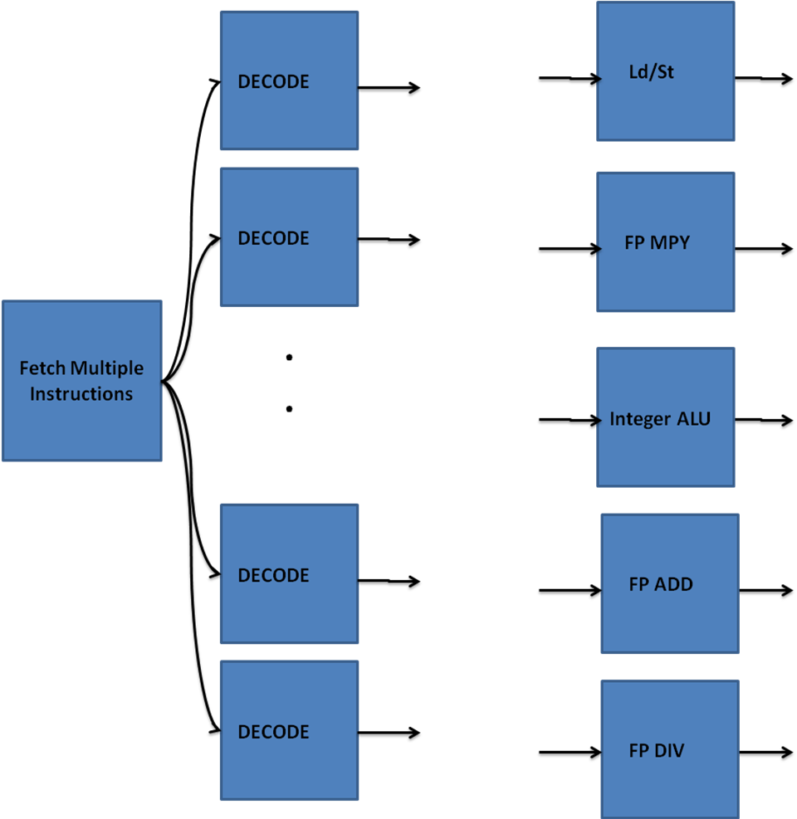
Superscalar pipelines

Slide 175
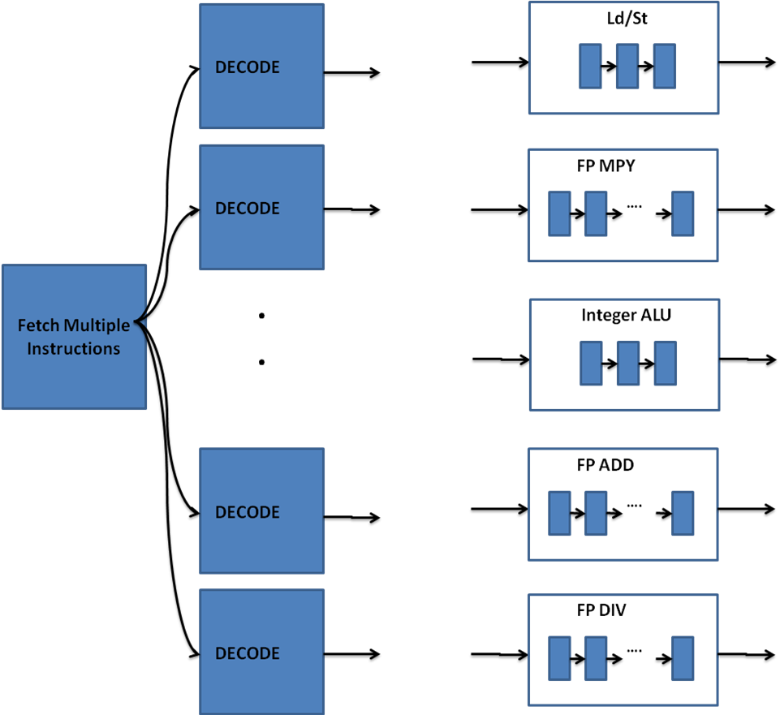
Different Pipeline Depths

Slide 176
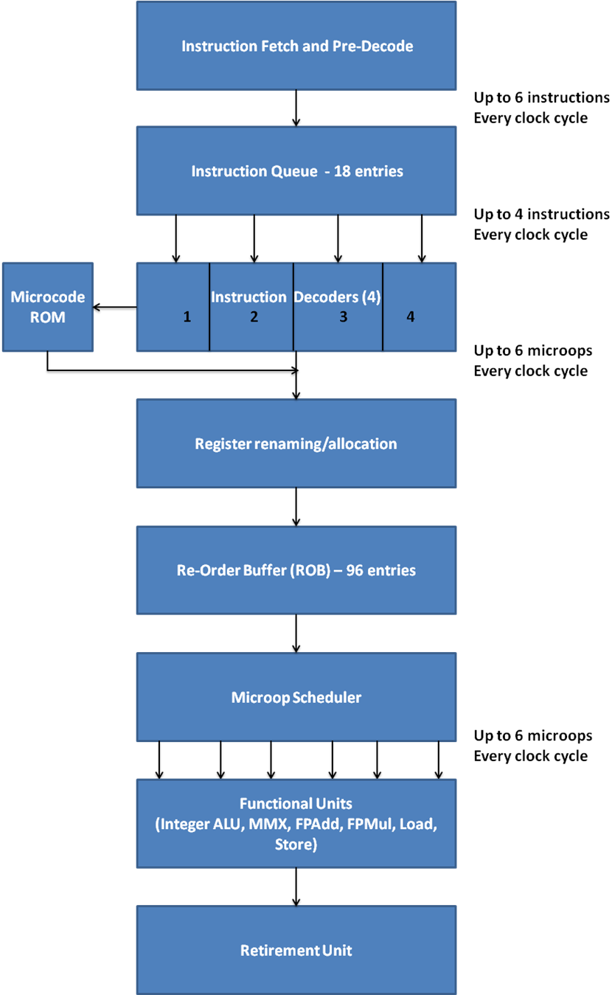
Intel Core Microarchitecture: An example pipeline
CISC style instructions
RISC style instructions
Really complex instruct-tions and excep-tions

